Slide 1
SUSE® Openstack Cloud
and the “DevOps” approach
Cameron Seader
SUSE Systems Engineer
cs@suse.com
Rick Ashford
SUSE Systems Engineer
rashford@suse.com

Slide 2


Slide 3
Agenda
Introductions
Development and Operations
The SUSE Approach
The Tools
Architecture and Workflow
How can SUSE Help?

Slide 4
Development and Operations

Slide 5
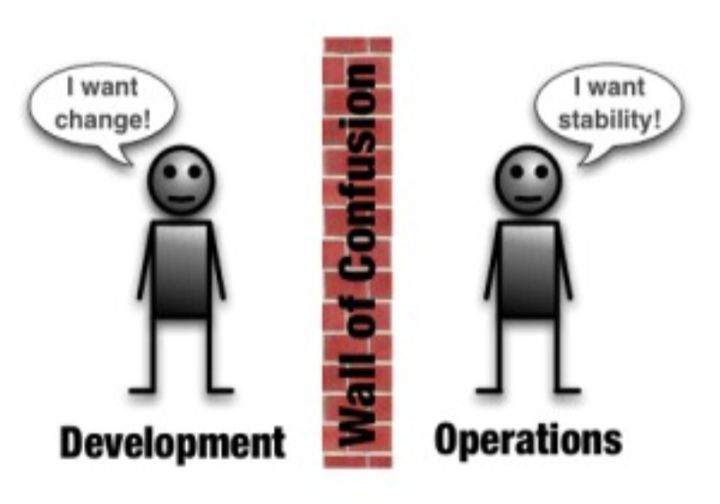
Traditional approach…

Slide 6
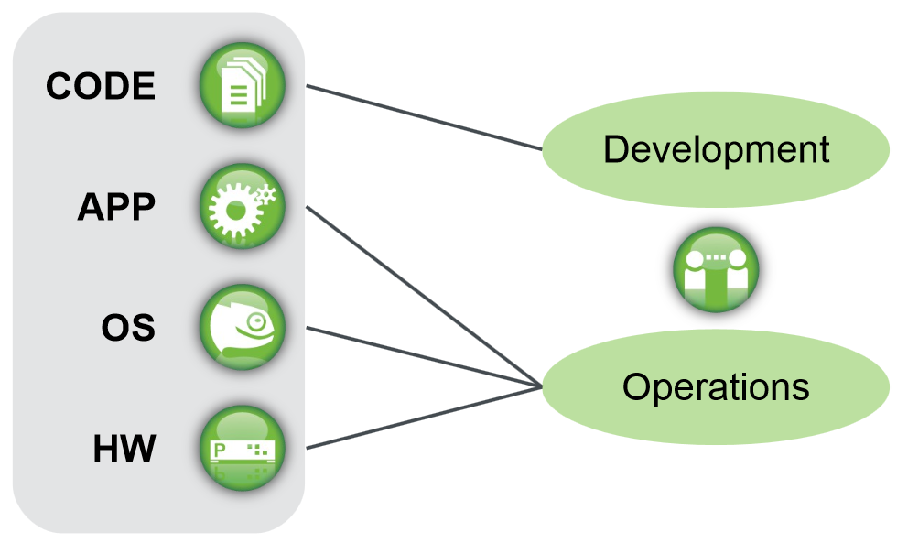
Traditional approach…
Development produces code - publishes it, then starts on the next release cycle.

Slide 7
New Approach…
DevOps to the rescue!!
Stresses communication, collaboration and integration between software developers and information technology (IT) operations professionals.

Slide 8
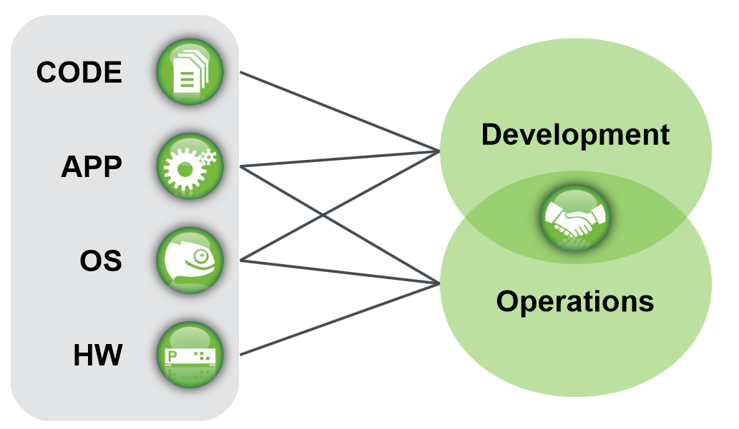
The DevOps Way

Slide 9
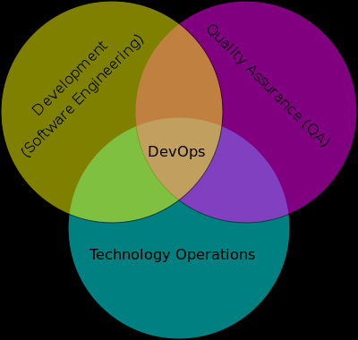
DevOps

Slide 10
Problem Statements

Slide 11
Typical Problem Statements
Software Packaging and Image Creation :
Customized scripts for configuring services via config file templates is difficult to manage. When consolidated to a single RPM, changes to a service require an RPM rebuild
.
Standards not always followed, with no enforcement controls for them.
Kernel-dependent components are impacted with every upgrade.
Typical deployments of apps/middleware components are complex.
    Difficult to identify which files are required for an application when spread over multiple RPMs.
    Deployment teams have difficulty identifying which part of the app to deploy

Slide 12
Typical Problem Statements
Imaging / Packaging / Patching / Upgrades:
  Difficulties decoupling middleware/application upgrades from OS-related upgrades
  Building new images for new OS versions is usually approached by building and re-building from scratch
  This typically requires project initiation and implementation every time, with significant overhead costs.

Slide 13
The SUSE Approach

Slide 14
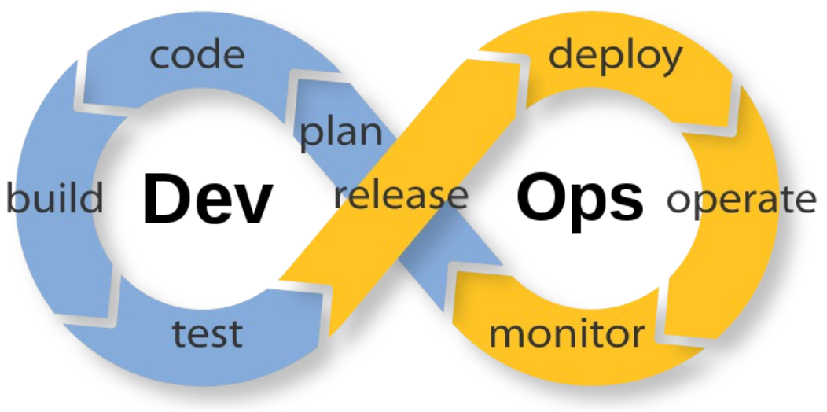
The SUSE Approach…
SUSE is more than just a Linux distribution, we create software that helps people solve problems & quickly adapt to business and industry changes.
SUSE was founded on the approach of research and development - focusing on high-quality engineering. It is one of our key differentiators in the market.
SUSE software is engineered for continuous delivery

Slide 15
The SUSE Approach…
Software Und Systeme Entwicklung
=
Software & Systems Development

Slide 16

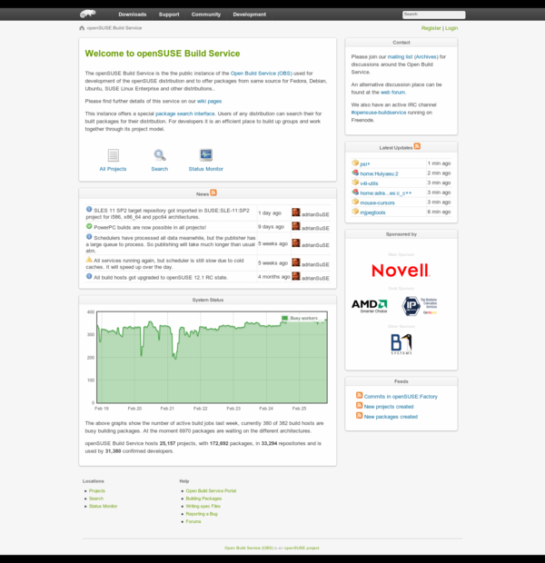
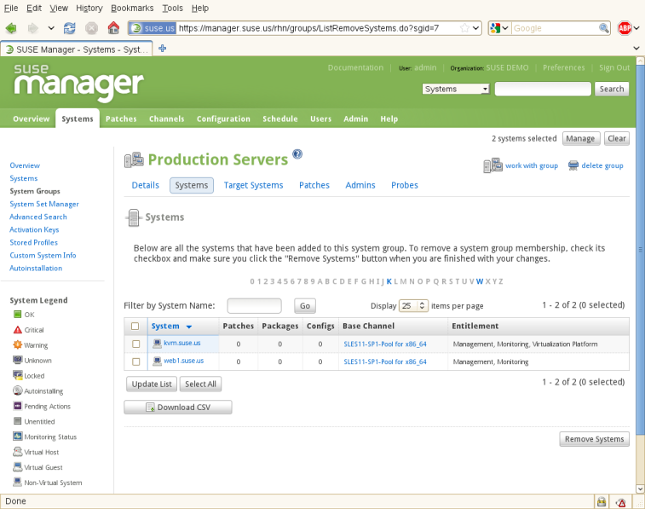
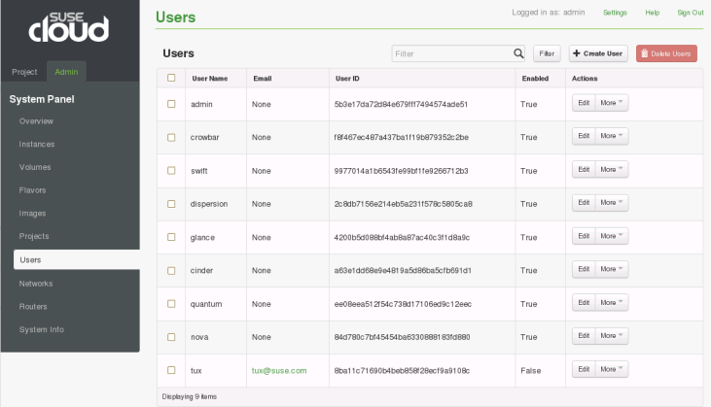
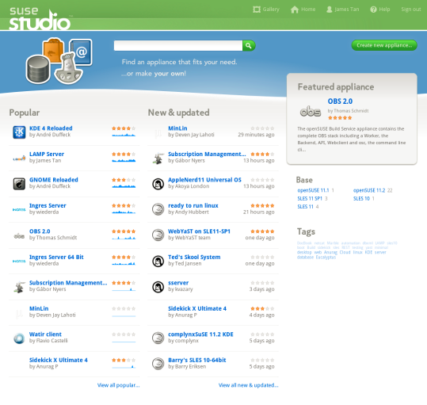
The SUSE Approach…
SUSE design principles:
Open Source & Open Development
APIs
Standards-based (protocols, languages, etc)
Enterprise focus

Slide 17
Concept

Slide 18

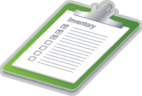
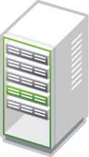

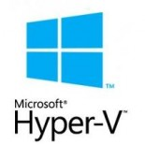









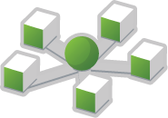
Concept
Report
KIWI
System Inspection SLES 12 “Machinery”
Various Output Format
openQA
YaST / AutoYaST
Develop.…...........Build.....................Test................Deploy

Slide 19
Concept
Leverage these components for developing, building, testing, integrating and managing hosts :
PACKAGE :
Open Build Service - www.openbuildservice.org
BUILD :
SUSE Studio - www.susestudio.com
DEPLOY :
Virtual Workloads via SUSE OpenStack Cloud, VMware ESX, Cisco UCS, other image deployment mechanisms www.suse.com/products/suse-cloud/
MANAGE/MONITOR:
SUSE Manager, Nagios www.suse.com/products/suse-manager/

Slide 20
SUSE (and other) Tools

Slide 21
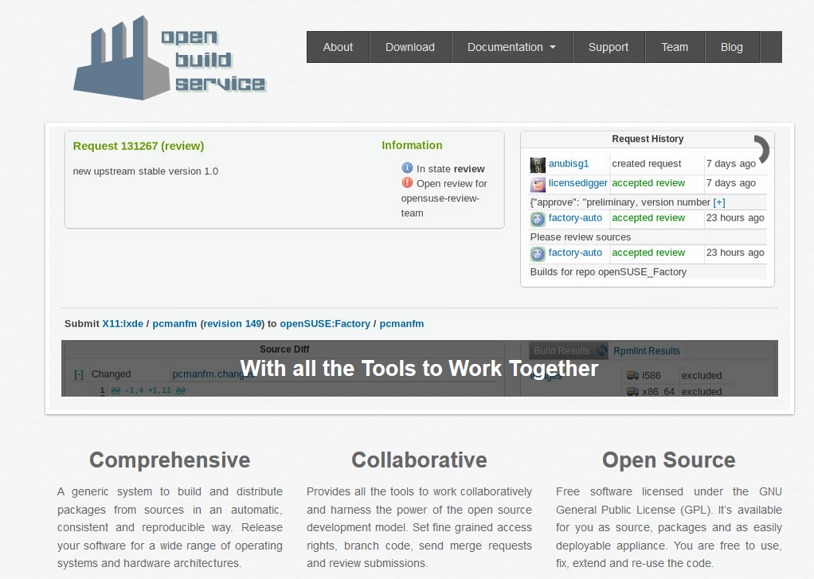
SUSE Components
PACKAGE :
Open Build Service
Web Client and a CLI (osc)
Allows for simple package creation
Upload sources with wget or via web client
Import or copy source packages
Add repositories
Build packages locally or on source server
Reporting
Collaboration via branching/merging/review/commit - request tracking
Version testing

Slide 22
SUSE Components
PACKAGE :
Open Build Service
Even Image Building is possible
with OBS
Development can be done at an
  Individual level
  OR at a project level with several contributors and multi-level review
See here for more details (videos, talks and workshops)
: http://openbuildservice.org/help/materials/

Slide 23
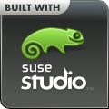
SUSE® Studio
Fastest, Easiest Way to Create Appliances
SUSE Studio Online
    Free hosted appliance creation tool
    Build in minutes with just a few clicks
    SUSE Linux Enterprise (SLE) 11 SP2 / SP3, SLE 12, OpenSUSE 13.2
    Template-based image creation
    Output formats include Xen, KVM, VMware, Hyper-V, Live CD/DVD, raw disk images
    Cloud image creation / deployment for Amazon EC2, Microsoft Azure, Openstack
    Includes gallery for showcasing appliances
    Try it out at http://susestudio.com

Slide 24


Modules: An Easier Way to Get New Enhancements
Easier access to the latest updates
Different lifecycles, ranging from continuous
integration to three years
Fully maintained and supported
Included in subscription without
additional cost
Five optional modules besides base OS
Notes:
SUSE Enterprise Linux Server 12 delivers some packages that require different frequency of update—enterprise-ready and in a timely manner—in five optional modules. The lifecycles of these modules range from continuous integration to three years and differ from the base server operating system lifecycle of up to 13 years. Unlike the traditional monolithic service pack model, the modules address your need for timely updates in some rapidly changing areas like cloud and development tools. With the modules you don’t have to wait until the next, or even a future, service pack to get high-quality, lead-edge technology. The modules are available, free of additional charge, to all SUSE Linux Enterprise Server 12 subscribers from its module-specific channel of distribution in the SUSE Customer Center.
Differentiator:
RHEL Software Collections is not completely free to all subscribers. And RHEL Software collection only include part of our module packages (mostly in web and scripting area). See here:
http://developerblog.redhat.com/2013/09/12/rhscl1-ga/

Slide 25
Modules: A Closer Look
Module Name | Content | Lifecycle
Web and Scripting Module | PHP, Python, Ruby on Rails | 3 years, 18 months overlap
Legacy Module | Sendmail, old IMAP stack, old Java, etc. | 3 years
Public Cloud Module | Public cloud initialization code and tools | Continuous integration
Toolchain Module | GCC | Yearly delivery
Advanced Systems Management Module | cfengine, puppet and the new machinery tool | Continuous integration
Notes:
The five optional modules are:
Web and Scripting Module: The SUSE Linux Enterprise Web and Scripting Module delivers a comprehensive suite of scripting languages, frameworks and related tools, helping developers and systems administrators accelerate the creation of stable, modern web applications by using dynamic languages, such as PHP, Ruby on Rails, and Python.
Legacy Module The Legacy Module helps you migrate applications from SUSE Linux Enterprise 10 and 11 and other systems to SUSE Linux Enterprise 12 by providing packages that are discontinued on SUSE Linux Enterprise Server such as sendmail, syslog-ng, IBM Java6, and a number of libraries (for example openssl-0.9.8).
Public Cloud Module The Public Cloud Module is a collection of tools that enables you to create and manage cloud images from the command line on SUSE Linux Enterprise Server. When building your own images with KIWI or SUSE Studio, initialization code specific to the target cloud is included in that image.
Toolchain Module This module offers software developers a current toolchain consisting of GNU Compiler Collection (GCC) and related packages as well as updated applications from improvements , new standards and additional hardware features. Because SUSE Linux Enterprise 12 contains a reasonably new version of the toolchain stack, the first version of the Toolchain Module will be released in 2015.
Advanced Systems Management Module This module contains three components for systems management: the configuration management tools cfengine, puppet and the new "machinery" tool. Machinery is a systems management toolbox that allows you to inspect systems remotely, store their system descriptions and create new systems to deploy them in data centers and clouds. The three systems management tools allow system administrators to automate tasks in the data center and cloud.

Slide 26
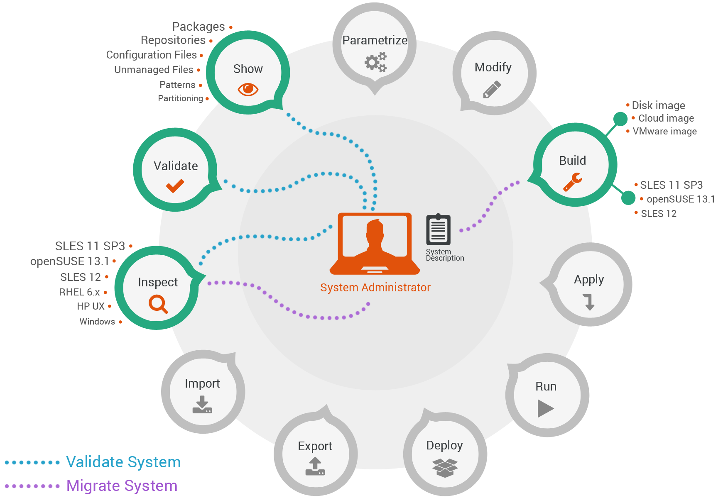

Advanced Systems Management
Module – Machinery

Slide 27
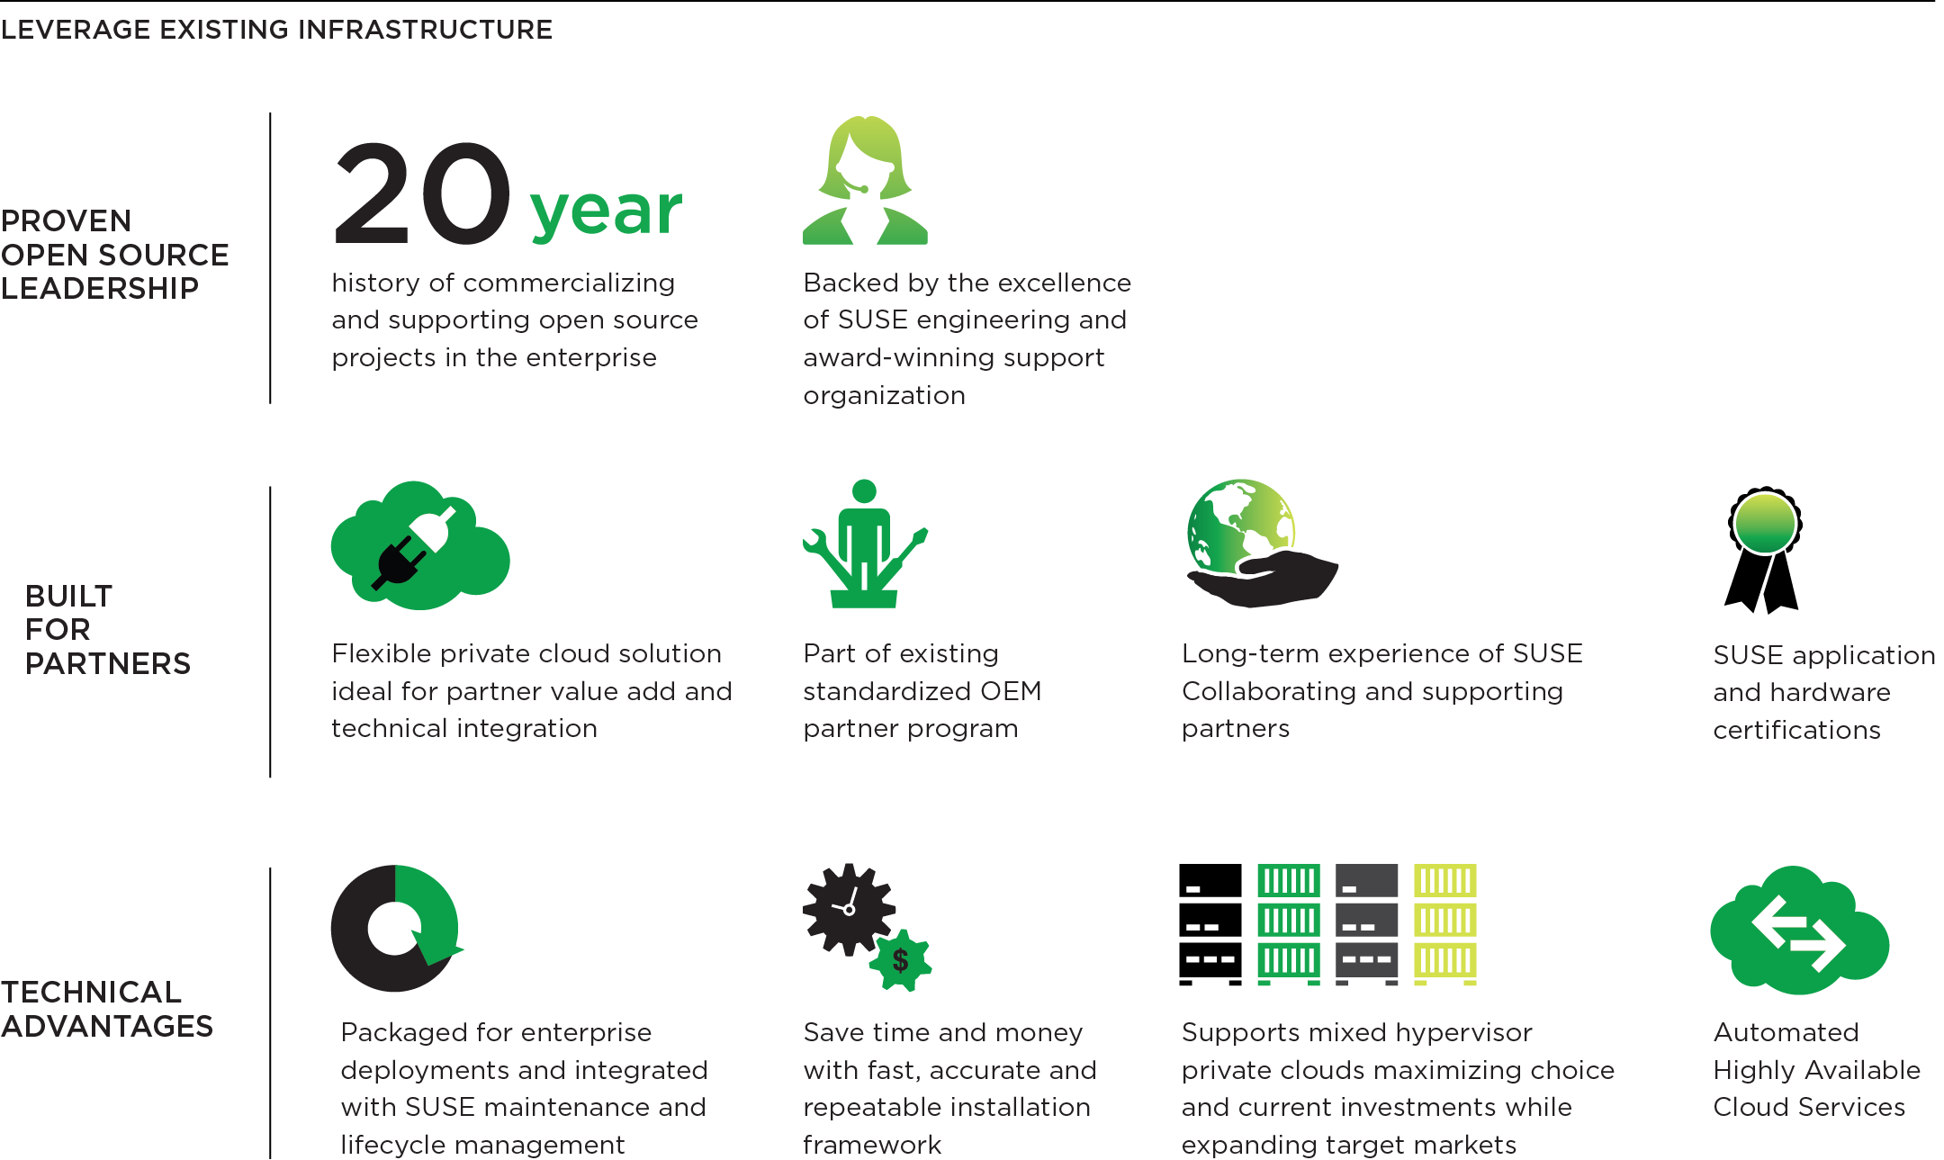
Platform for Your Data Center Evolution
Enterprise OpenStack Distribution
  Leading open source cloud project delivering fast innovation of advanced IaaS cloud services
Integration with Ceph Distributed Storage
  Reduce costs with a single software-defined storage solution for massively scalable and reliable block, object, and image storage
Driver of Organizational Innovation
  Develop and deploy new applications that take advantage of SUSE OpenStack Cloud capabilities
Award-Winning Worldwide Support
  Backed by the excellence of SUSE engineering and the only organization with a 20-year history of supporting open source software
Notes:
As discussed earlier, OpenStack provides a long-term foundation to build an IaaS private cloud on. It offers Offers faster innovation and greater choice with the enterprise support you need by providing organizations the benefits of open source development, while ensuring stability and security. The openness of SUSE Cloud and the vibrant community of technology leaders contributing to the OpenStack project not only provides a continuous stream of innovation, but reduces vendor lock-in. Designed to make it easy for enterprises to harness the power of OpenStack for private cloud deployments SUSE Cloud is our enterprise-ready OpenStack distribution based on OpenStack Havana and uses Crowbar as part of the install framework to help simplify the installation and ongoing management of your private cloud environment.
SUSE Cloud delivers on the promise of a private cloud by allowing you to deploy a secure, compliant fully supported cloud environment within your firewalls.
By using SUSE Cloud, IT and the business can work more closely together. They can react quickly to changing business demands and reduce costs by automating the creation of virtual servers and deploying workloads on them. Additionally, as organizations can create a virtuous cycle of innovation by taking greater advantage of the cloud's rapid scalability and automation.
SUSE has a 20 year history of commercializing and supporting open source projects in the enterprise SUSE Cloud is rigorously tested, includes 24x7 worldwide technical support The product is backed by the excellence of SUSE engineering and support and our award winning
Utlimately, SUSE Cloud will allow you to be the cloud service provider of choice for your enterprise.

Slide 28
Fast Installation and
Simplified Management
SUSE OpenStack Cloud
Administration Server
  Faster ROI through faster installation and easier management of OpenStack Cloud
Highly Available Cloud Services
  Maintain business agility and deliver enterprise-grade SLAs through continuous availability of cloud services
Standardized Product Life Cycle
  Packaged product integrated with SUSE update and maintenance processes to ensure simplified enterprise maintenance
Notes:
The SUSE Cloud Administration Server includes an installation framework that dramatically simplifies deployment and ongoing administration of an OpenStack physical cloud infrastructure. Automating deployment and management Tasks improves IT staff productivity, while providing enterprises with maximum flexibility to configure their clouds to meet specific needs.
SUSE Cloud provides automated configuration and deployment of the cloud controller through the SUSE Cloud Administration Server. The cloud control is where all of the critical functionality for operating the cloud resides. Once a private cloud is put into production, IT does not want the cloud to go down. SUSE Cloud HA ensures that cloud users will have continuous access to the cloud, so they can maintain agility. HA also provides assurances to IT that they can deliver enterprise-grade SLAs.
SUSE Cloud is fully integrated into the SUSE Customer Center and update processes, so enterprises can easily patch and maintain their cloud deployments just like they would their OS.

Slide 29
Take Advantage of Ecosystem and Skills
Supports Mixed KVM, Xen,
Microsoft Hyper-V, and VMware Clouds
  Increase flexibility in cloud design while maximizing performance and optimizing licensing costs for workloads
SUSE Hardware and
Application Certifications
  Confidently run SUSE OpenStack Cloud on industry standard hardware and deploy the applications you want in the cloud
Open APIs for Integration
with Third-Party Solutions
  Maintain current IT investments or expand capabilities to build cloud to unique requirements
Notes:
SUSE Cloud expands the enterprise capabilities of your IT infrastructure, while maintaining current investments by offering support for a broad choice of third-party solutions. SUSE Cloud helps to maximize workload performance and optimize licensing costs of virtual environments by delivering mixed hypervisor support for organizations using KVM, Xen, Microsoft Hyper-V, and Vmware. SUSE also supports many networking, storage and manage ment solutions, so organizations can construct an enterprise- ready private cloud that meets IT and business requirements.

Slide 30
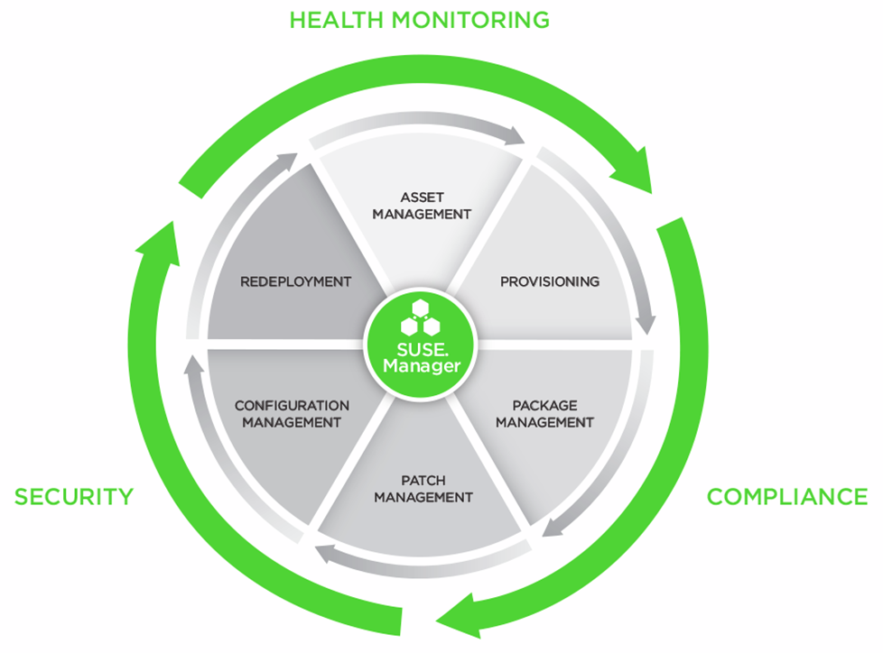
SUSE Manager:
Operating System Lifecycle Management
Gain control
Optimize operations
Enable innovation
Notes:
Manager functionality can be categorized into two main groups:
“outer circle”: gain back control with Manager's health monitoring, compliance & security features
“inner circle”: optimize and automate operations for your complete OS lifecycle management process, from Asset Management to Provisioning, Software & Patch Management, Configuration Management and Redeployment
Optional: Mention ITIL:
“Supports your ITIL Service Transition and Service Operation workflows
With more automation and control SUSE Manager gives your teams time back they need for innovation and can be a key enabler for driving this innovation (e.g. moving to a Cloud-centric datacenter operation)

Slide 31

Non-SUSE Components
Version Control:
Subversion, GIT, Mercurial, etc
For code commits
Integrates with OBS as sources/repos
CI (Continuous Integration) Orchestration:
Jenkins
  http://jenkins-ci.org
  “Like cron on steroids”

Slide 32
We are here to help!

Slide 33
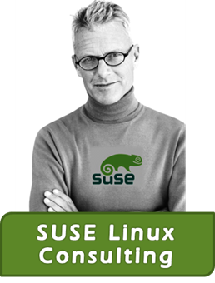
“Bringing
SUSE Solutions to Life”
Knowledge
Expertise
Experience

Slide 34

SUSE Consulting Solutions
Plan
Optimize
Unix to SUSE Migrate Plan
SAP on SLES Plan
SUSE Linux Health Check
SAP & HANA Workloads
Secure
Assist
Basic Security Assessment
Penetration Testing
SUSE Linux Expert
Implement
Start
SUSE Linux - High Availability
SUSE Linux - Retail Design
SUSE Linux for SAP Applications
SUSE Manager Solution
SUSE Linux core build
Unix to SLES Migration
SUSE Start: SUSE Manager
SUSE Start: SUSE Studio
SUSE Start: SUSE Cloud
SUSE Start: PUM

